Slide 1
HOTEL MANAGEMENT SYSTEM
presentation

Slide 2
ABSTRACT
In order to make the hotel management work systematic, standardization and automation, achieve the aim of improving the efficiency of hotel guest room management. This paper designs the hotel management system, the overall mission of system development is to make the office staff can quickly and easily complete the hotel guest room management task. From the Angle of actual application to system illustrate the basic situation; And then introduced the system analysis and modeling, focusing on the functional requirements of the hotel management system was analyzed, at the same time on the system design goal, the system use case diagram and so on several aspects, etc. Application of this system can be flexibly and conveniently on the computer management hotel rooms, thus greatly improves the processing speed, make the management more modern.

Slide 3
INTRODUCTION
With technology advancing now faster than ever before, everyone needs and demands using the latest technological means just to survive. Such is the case in the hotel industry too, especially in the upper-class and boutiques hotels area of the market.
The project, Hotel Management System is a web-based application that allows the hotel manager to handle all hotel activities online.
The website is aimed at facilitating the prompt, accurate and easy management of a hotel
Interactive GUI and the ability to manage various hotel bookings and rooms make this system
very flexible and convenient.

Slide 4
Hotel management project provides room booking, staff management and other necessary hotel management features. The system allows the manager to post available rooms in the system.
This is a website for managing the general managing of a hotel like booking,
billing, etc.
The purpose of this document is to collect, analyze and define the need and
features of the hotel management system.

Slide 5
LITERATURE SURVEY-1
Hotel management and marketing on the internet: An analysis of sites and features
Author: Jamie Murphy, Edward J. Forrest,C.Edward Wotring,Robert A. Brymer
Publication: The Cornell Hotel and Restaurant Administration Quarterly
Many hotel managers and hotel-operating companies are attempting to use the internet and worldwide web as an effective management and marketing tool. An exploratory survey finds thousands of hotel-related sites. Available functions of a web page include: travel information, reservations and payment, special promotions, links to partners, direct consumer feedback, employment opportunities, audio and video ads, gift certificates, shareholder information, newsletters, frequently asked questions, and a list of and links to individual hotels. For any web site, there are five important considerations for its successful management: defining the mission, calculating the margins, addressing the mechanics, planning the marketing, and performing the maintenance.

Slide 6
LITERATURE SURVEY-2
What Makes for a Successful Hotel? Insights on Hotel Management Following 15 Years of Hotel Occupancy Analysis in England
Author: D. Jeffrey , R.R.D. Barden , P.J. Buckley & N.J. Hubbard
Publication: The Service Industries Journal
Time series analyses of daily and monthly occupancy rates in different samples of hotels in England over a 15-year period reveal consistent temporal components of occupancy performance. These differentiate hotels in terms of overall occupancy levels, seasonality, length of season, trend and within-week variations. The components are related to the characteristics of hotels and their management using statistical methods and structured interview surveys, and the factors affecting occupancy performance of hotels are identified and calibrated.

Slide 7
LITERATURE SURVEY-3
A review of the literature on culture in hotel management research: What is the future?
Author: Rose X.Y. Chen,Catherine Cheung,Rob Law
Publication: International Journal of Hospitality Management
This paper aims to provide insights into the development of research on culture in the hotel industry by reviewing the existing literature. The papers were categorized into six major groups according to Pizam's (1993) hierarchy of cultures, and were further sorted by year of publication, source, subject area, region of focus, and the nature of the research. In contrast, few studies have investigated industry, occupational, and corporate cultures in association with hotel management studies, prompting concern for future research. In summary, this review paper offers a first and important attempt to understand the development of research on culture in the hotel management field and identifies future research opportunities.

Slide 8
LITERATURE SURVEY-4
Competencies for Hotel Management: Industry Expectations of Education
Author: Tom Baum
Publication: International Journal of Contemporary Hospitality Management
This article considers the very important issue of the expectations that employers in the hotel sector hold regarding graduate entrants. The article reports on a study in the UK which replicates and compares findings with a similar survey in the USA – 36 key competencies were rated by 118 general managers of hotels with more than 150 bedrooms. Conclusions are drawn with respect to the priority given to these competencies; their implications for educators; and the cultural variation implicit in comparing the US and UK findings.

Slide 9
LITERATURE SURVEY-5
Does hotel management matter to overcoming the COVID-19 crisis?
Author: Alberto Hidalgo, David Martín-Barroso , Juan A. Nuñez-Serrano,Jaime Turrión,Francisco J. Velázquez
Publication: Tourism Management
This paper analyses the influence that the initial actions and strategies pursued by hotel managers have on the recovery of occupancy after a crisis such as the COVID-19 pandemic. To do this, a specific survey is carried out on managers of Spanish hotels. The main findings show that labor actions, especially plans for temporary employment regulations, innovation and differentiation strategies, reorientation to closer markets and obtaining information from official sources as a guarantee of their certainty, are the measures that have a greater impact on the possibilities of recovering hotel activity. In addition, government measures that contribute to the improvement of the financial situation of firms can also play a relevant role in hotel recovery.

Slide 10
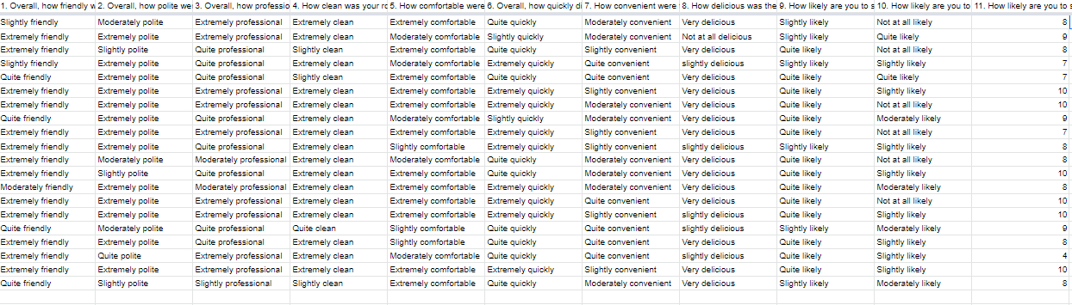
TABULAR REPRESENTATION OF THE SURVEY

Slide 11
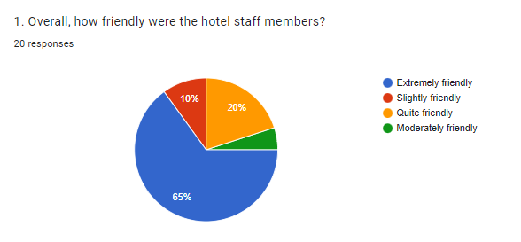
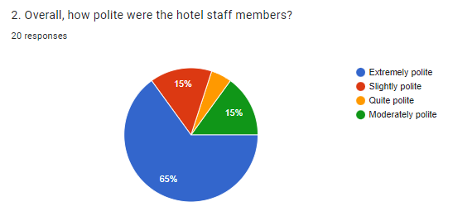
HOTEL STAFF BEHAVIOR

Slide 12
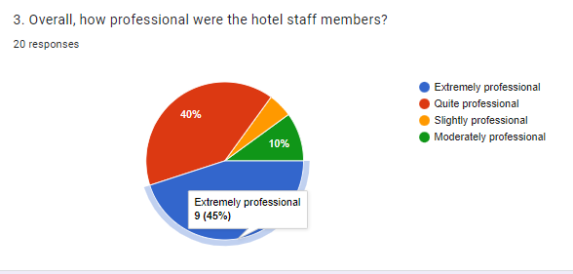
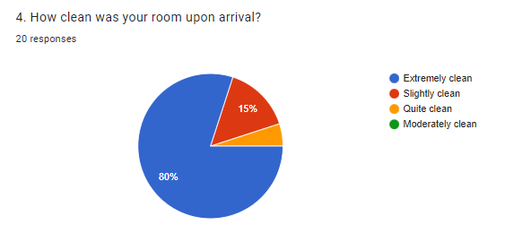
HOTEL STAFF BEHAVIOR

Slide 13
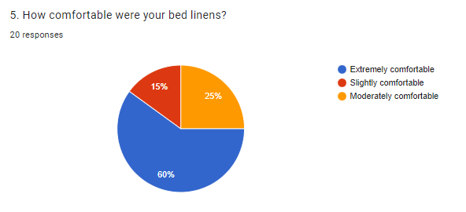
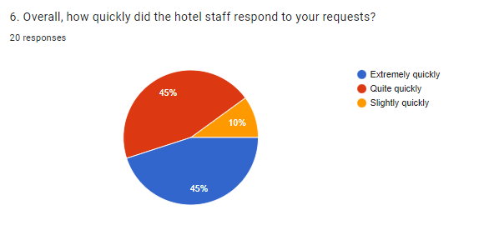
ROOM AND FOOD SERVICE

Slide 14
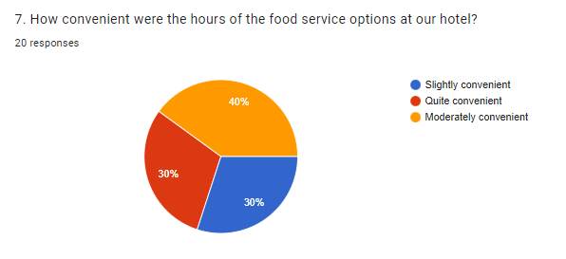
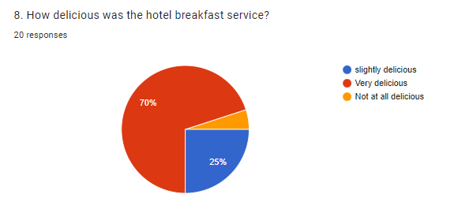
ROOM AND FOOD SERVICE

Slide 15
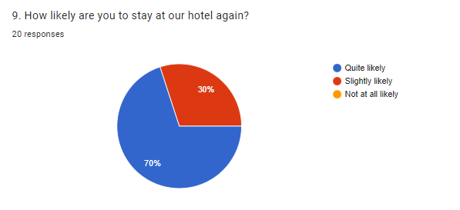
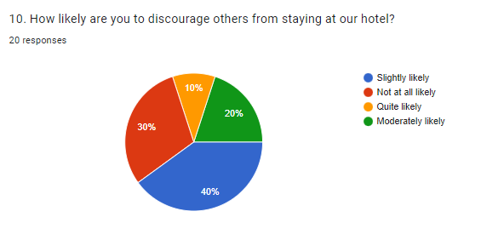
OVERALL REVIEW

Slide 16
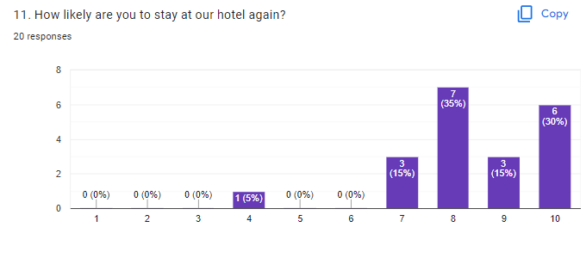
OVERALL REVIEW

Slide 17
OBSERVATION AND RESULT
The above conducted survey shows the management that is
carried out by the hotel :
It shows that the staff were extremely polite and friendly to the customers.
It shows that the rooms and the corridors were pretty clean and fresh for the customers.
It seems that they were also pleased with food options and the taste of the food.
It is found that the customers are more likely to return to the same place and recommend it to others.

Slide 18
CONCLUSION
The conclusion of this project is A Hotel management system is a computerized management system. This system keeps the records of hardware assets besides software of this organization. Reports are made on daily basis for every customer check in or check out which can easily be seen by the management. Hotel management system has also primary purpose is to provide facilities to customers. A software for computers makes the things many times easy, these are made as user friendly and to keep an check and balance in hotel management and accounts as well. This software application will help admin to handle customers information, room allocation details, payment details, billing information, etc. The existing system is a manually maintained system. All the Hotel records are to be maintained for the details of each customers, Fee details, Room Allocation , Attendance etc. provides easy and quick access over the data.

Slide 19
REFERENCE
https://www.mifratech.com/public/blog-page/Hotel+Management+System
https://studylib.net/doc/25667912/hotel-management-system-project-presentation
https://www.studymode.com/subjects/literature-review-for-a-hotel-management-system-page1.html
https://scholar.google.com/scholar?hl=en&as_sdt=0%2C5&q=hotel+management+&btnG=#d=gs_qabs&t=1664250084268&u=%23p%3D9f_dBGxATo8J
https://forms.gle/ZU3p4r9CZtjknxij6
https://journals.sagepub.com/doi/10.1177/001088049603700322
https://www.sciencedirect.com/science/article/abs/pii/0010880496868170

